Slide 1
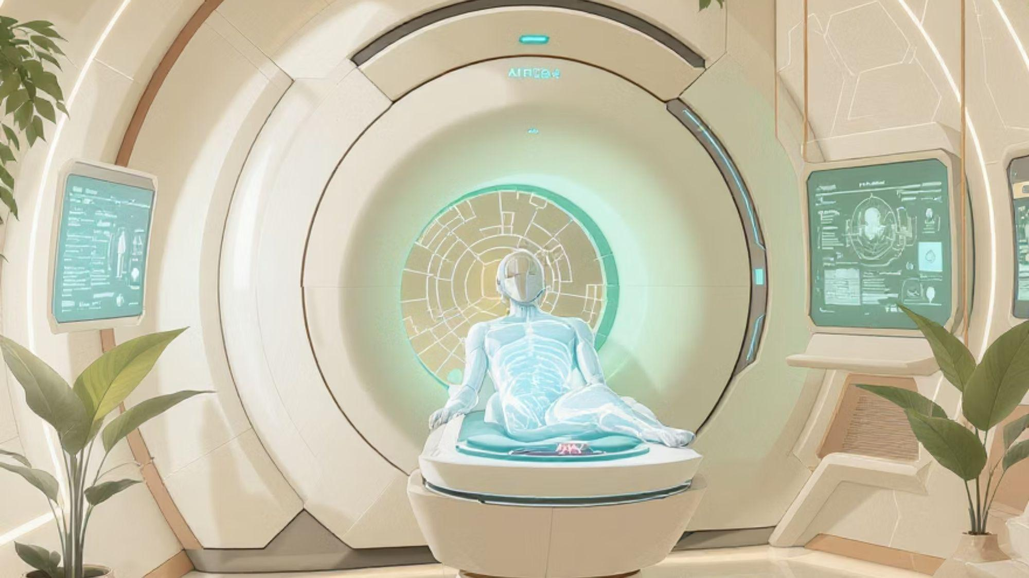


IILM UNIVERSITY
Med-VQA: A Multimodal AI for Medical Visual Question Answering
An Assistive Co-pilot for Radiology and Medical Education
Presented By: ARYAN JAISWAL | Roll Number: 25SCS1003000967
UNDER THE SUPERVISION OF : MR. RAMAVATH GANESH

Slide 2


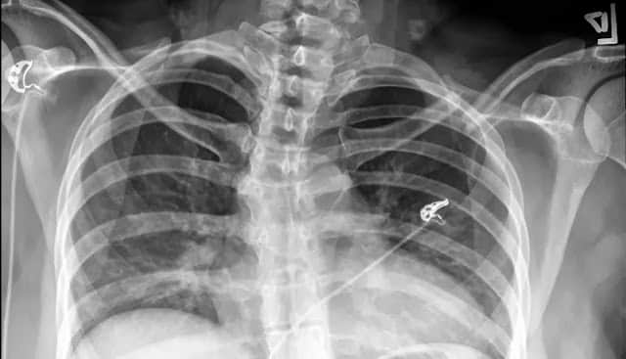
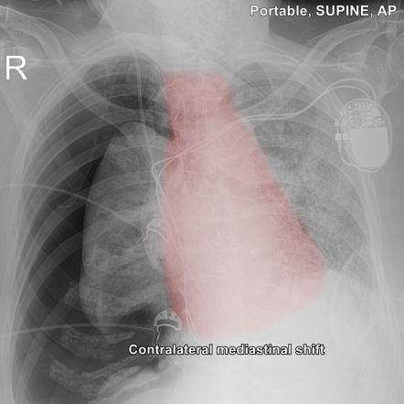
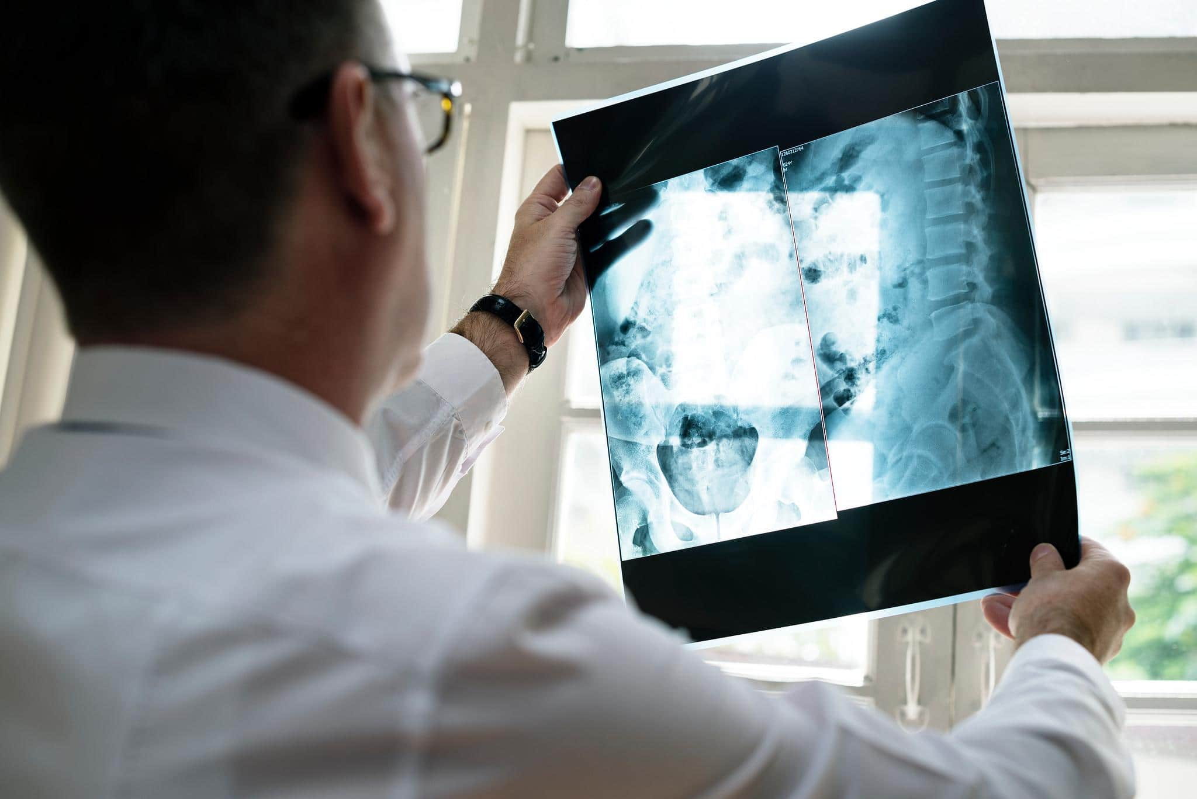
What is Medical VQA?
This project introduces an advanced AI system that proficiently understands both medical images and complex text queries.
The model takes two inputs:
A medical image (e.g., Chest X-ray, CT scan).
A natural language question (e.g., "Is there evidence of pneumothorax?").
It produces one accurate, text-based answer, such as: "Yes, a small pneumothorax is visible in the upper right lung field."
Our primary goal is to create a powerful assistive "co-pilot" for clinicians and to accelerate medical student training, not to replace medical professionals.

Slide 3
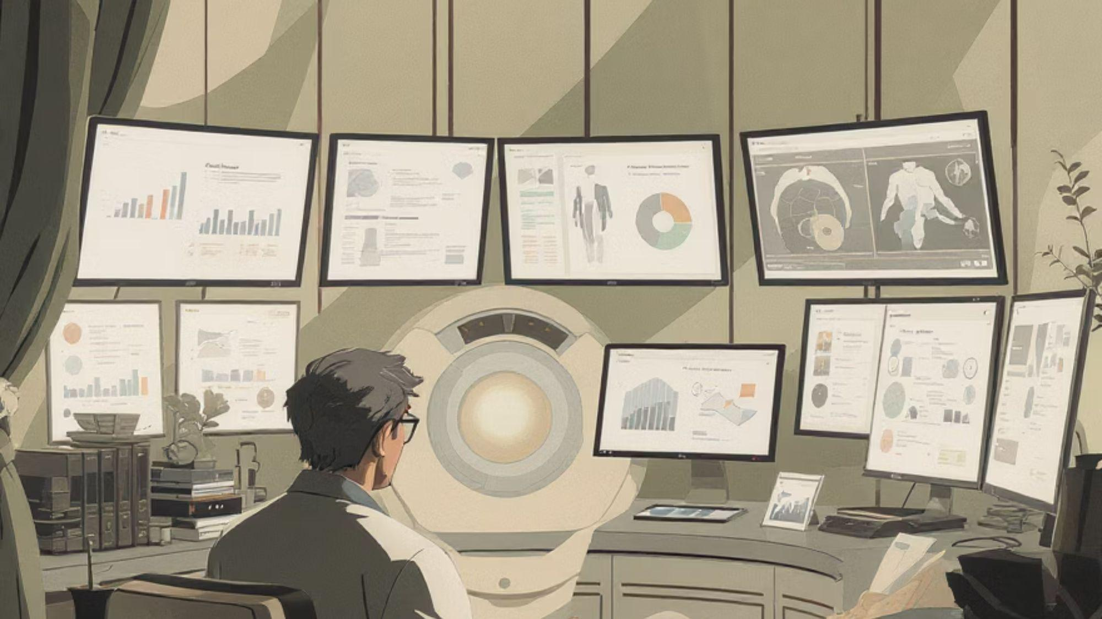
The Challenge in Modern Radiology
1
2
3
Clinician Burnout & Diagnostic Error
The Medical Training Bottleneck
Ambiguity & Data Scarcity
Radiologists face overwhelming workloads, reviewing hundreds of complex images daily, leading to fatigue and an increased risk of diagnostic errors.
Learning radiology is a prolonged "apprenticeship" requiring constant expert supervision. Students lack 24/7 interactive tools for immediate feedback.
Medical questions are inherently complex. Building robust AI demands massive, high-quality datasets annotated by medical experts, which are difficult and expensive to procure.

Slide 4

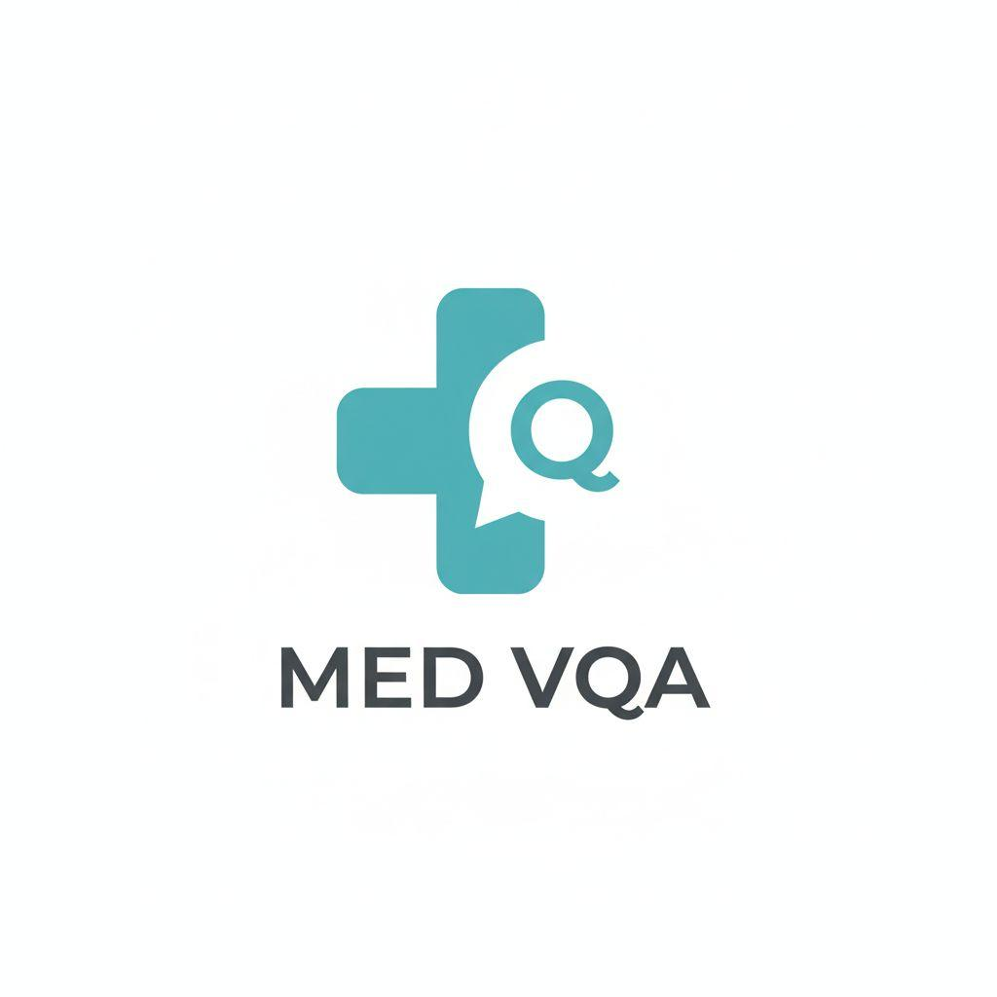



Our Solution: A Smart, Interactive AI Co-pilot
For Clinicians
MEDICAL VISUAL QUESTION ANSWERING
Our Med-VQA system acts as an AI co-pilot, offering a crucial "second look" to significantly reduce cognitive load. It answers specific, on-the-fly questions like "Where is the lesion located?", helping to verify findings and minimise errors.
For Medical Students
It functions as a 24/7 virtual tutor, enabling students to independently upload scans, ask questions, and receive instant, accurate answers. This radically accelerates the learning process and builds confidence.

Slide 5

Methodology: Data & Architecture
Our approach is meticulously built upon two fundamental pillars:
1. The Data (The "Fuel")
The model is trained on specialised, large-scale public datasets where images, questions, and answers are meticulously provided by medical experts.
VQA-RAD: General radiology Q&A covering diverse imaging modalities.
VinDr-CXR-VQA: A large-scale dataset focusing specifically on chest X-ray Q&A.
Med-MIM: A recent and expansive multi-image, multi-domain dataset for comprehensive training.
2. The Model (The "Engine")
We employ a Multimodal Fusion Architecture. This means the model utilises two distinct "branches" to process each input separately, before intelligently "fusing" them to derive the correct answer.
Dedicated visual processing branch.
Dedicated text comprehension branch.
Sophisticated fusion mechanism.

Slide 6




Implementation: A Three-Module System
The Vision Encoder
A pre-trained Vision Transformer (ViT) scans the X-ray, converting it into numerical features representing its visual content.
The Text Encoder
A pre-trained ClinicalBERT or BioBERT model reads the question, understanding its medical context and intent.
The Fusion & Answer Module
A Co-Attention Mechanism combines vectors, focusing on relevant image parts. A Classifier Head then selects the most likely answer from thousands of possibilities.

Slide 7
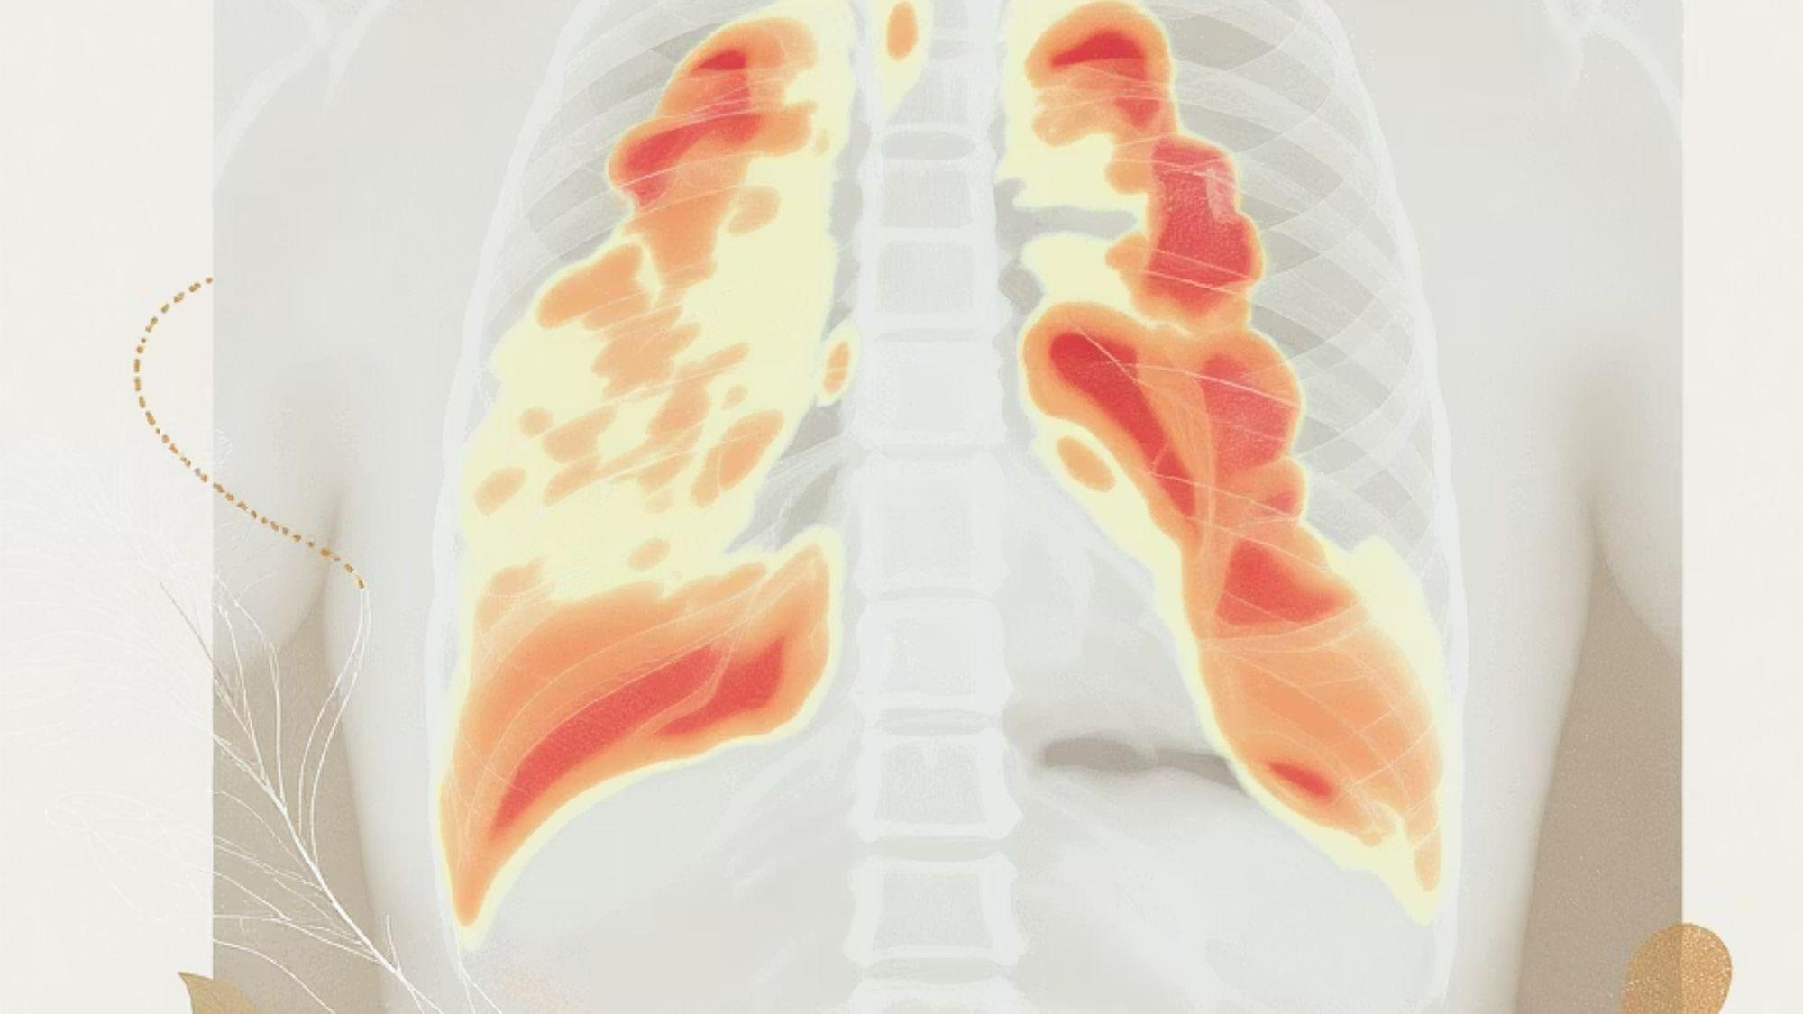
Outcomes & Evaluation
Measuring the success of Med-VQA goes beyond simple accuracy. We employ a multi-faceted evaluation approach:
VQA Accuracy
Automated Metrics
Explainable AI (XAI) Evaluation
A specialised metric that offers flexibility with wording, recognising semantic equivalents (e.g., "left lung" is understood as "the lung on the left").
We utilise metrics like BLEU and ROUGE, borrowed from natural language translation, to assess the quality and fluency of the generated answers.
A key 2025 trend, we not only demand correct answers but also require justification. We evaluate the model's justifications (its "chain of thought") and visual grounding (heatmaps) for medical relevance and coherence.

Slide 8

Conclusion & Future Work
Conclusion
We have designed a comprehensive blueprint for a Med-VQA system. This "co-pilot" has the profound potential to enhance patient safety in radiology and create a more sustainable environment for doctors. Moreover, it stands to revolutionise medical education by offering an interactive, on-demand learning tool for aspiring medical professionals.
Future Work
01
02
03
Improve Explainability
Expand Modalities
Build a Web Interface
Evolve from simple heatmaps to generating full textual justifications for answers, drawing inspiration from frameworks like "MedXplain-VQA".
Extend the model's capabilities by training it on other critical image types such as CT scans, MRIs, and Ultrasound images.
Develop a user-friendly web application where students can intuitively drag-and-drop images and input questions for seamless interaction.

Slide 9

References (2025)
Faria, F. T. J., et al. (2025). Analysing Diagnostic Reasoning of Vision–Language Models via Zero-Shot Chain-of-Thought Prompting in Medical Visual Question Answering. ResearchGate.
Gautam, S., et al. (2025). Medico 2025: Visual Question Answering for Gastrointestinal Imaging. arXiv:2508.10869.
Liu, Z., et al. (2025). R-LLaVA: Improving Med-VQA Understanding through Visual Region of Interest. arXiv:2410.20327v4.
Tariq, A., et al. (2025). Multimodal artificial intelligence models for radiology. BJR|Artificial Intelligence, 2(1).
Zhang, C., et al. (2025). Bridging the Semantic Gap in Medical Visual Question Answering with Prompt Learning. IEEE Transactions on Medical Imaging.

Slide 10
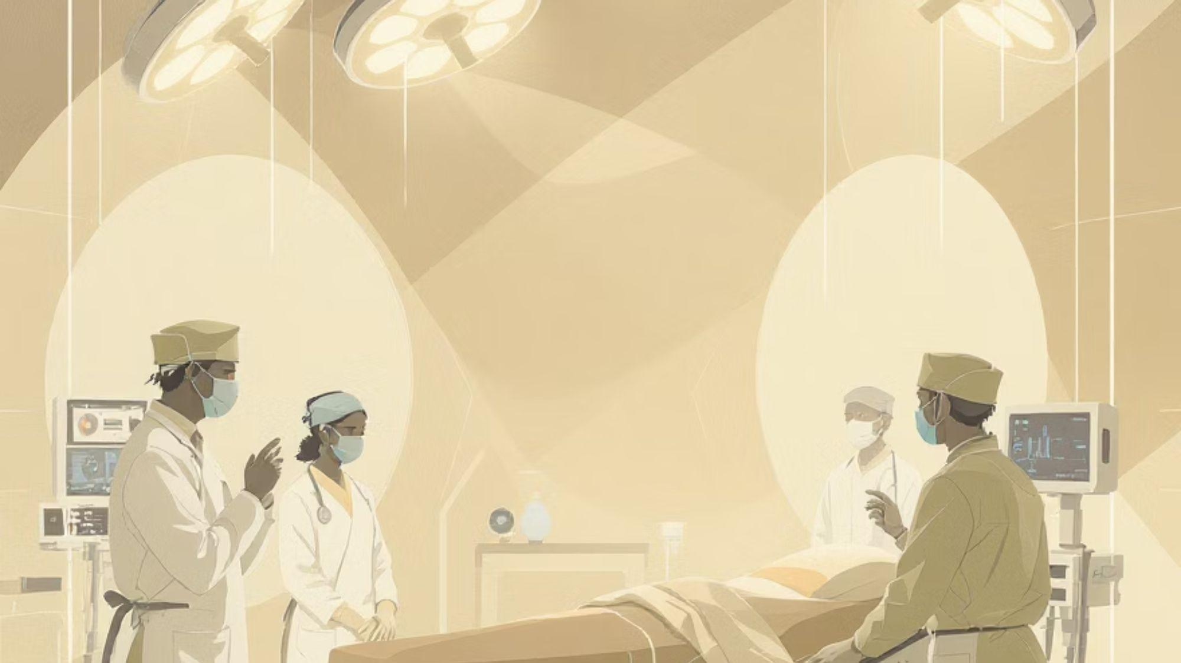
Thank You

